Slide 1
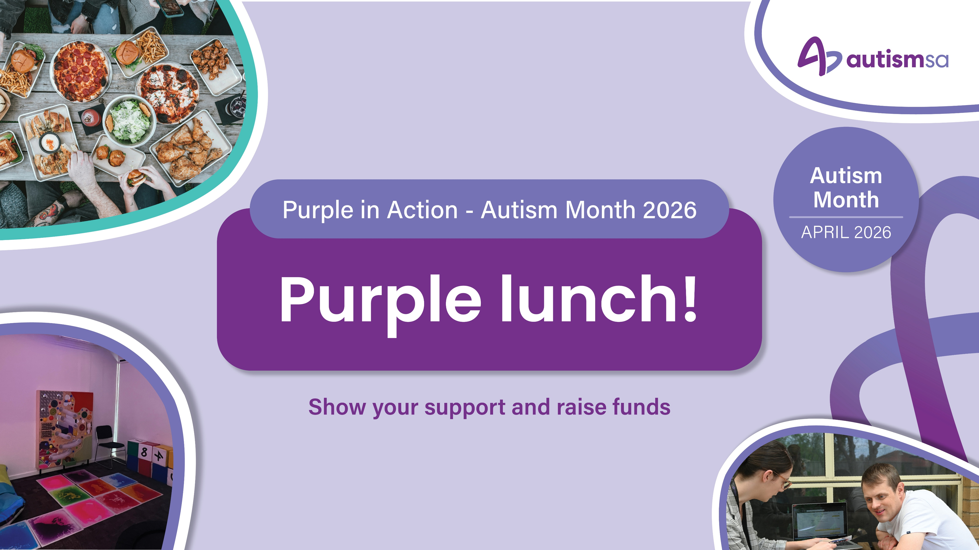

Slide 2
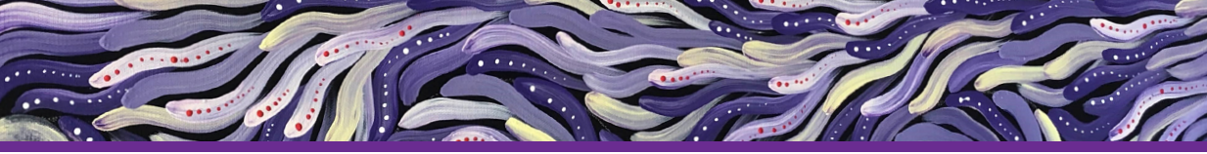
Acknowledgement of Country
We acknowledge this land that we meet on today is the traditional
lands for the Kaurna people and respect their spiritual relationship
with their country. We acknowledge the Kaurna people as the
custodians of the Adelaide region and that their cultural and
heritage beliefs are still as important to the living Kaurna people
today.
We pay our respects to the Elders past, present and emerging.

Slide 3

Schedule
Welcome (7 minutes)
Introduce the Autism SA Purple in Action campaign and video
Activities (10 minutes)
3 activities
Conversation (5 minutes)
Discussion
Wrap-Up (7 minutes)
To support Autism SA using the donation QR code.

Slide 4
Purple Lunch
Autism Month is an opportunity to recognise and celebrate different ways people think and experience the world.
Autism SA in SA autism peak body and has been supporting the Autistic and autism community for more than 60 years.
There are more then 290,900 autistic Australian living in Australia.
Today, Autism SA is inviting South Australians to:
get curious
celebrate difference
create welcome

Slide 5
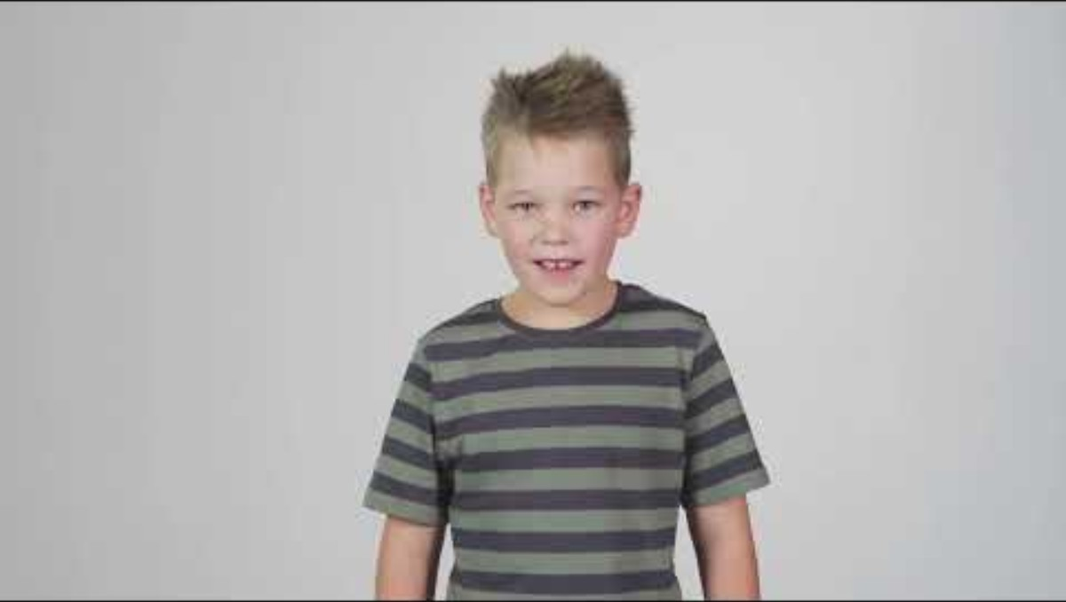
If the World Was Built For Me

Slide 6
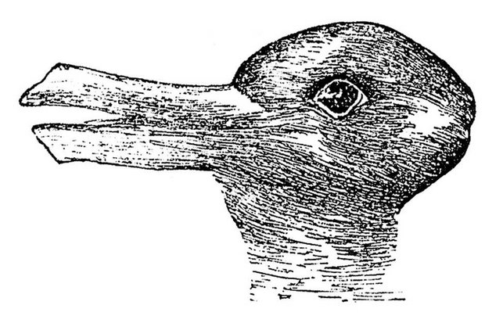
What animal do you see first?
Duck–Rabbit Illusion. Originally published in Fliegende Blätter (1892);
discussed by Joseph Jastrow in The Mind's Eye (1899).
Notes:
Let’s start with a quick activity.
Take a look at this image and decide what you see first.
Do you see a rabbit…
or a duck?
Just raise your hand once you’ve decided.
(Short pause)
What’s interesting about this image is that both answers are correct. The picture itself hasn’t changed — but people often see different things first.
Some people immediately see the duck, while others immediately see the rabbit.
And once someone points out the other option, you can usually switch between the two.
This is a great example of how our brains interpret information differently, even when we are all looking at exactly the same thing.
Our brains naturally look for patterns and meaning based on our experiences, the details we focus on, and the way we process information.
So two people can look at the same situation and notice completely different things.

Slide 7

A vase or two faces?
By Bryan Derksen - Original image Cup or faces paradox.jpg uploaded by Guam on 28 July 2005, SVG conversion by Bryan Derksen, CC BY-SA 3.0, https://commons.wikimedia.org/w/index.php?curid=1733355
Notes:
Now let’s try another quick example.
Now take a moment to look at this image.
Some people immediately see two faces looking at each other.
Others see a vase or goblet in the middle.
Again, the image hasn’t changed — but what we focus on changes what we see.
Once you notice both possibilities, your brain can often switch between them.
This illusion helps show that people naturally focus on different details and patterns.
And that difference can be really valuable.
Link to the Purple in Action Message
In workplaces and communities, people often notice different things in the same situation.
Someone might spot a risk, another might see an opportunity, and someone else might notice a detail others missed.
When we bring together different ways of thinking, we get richer ideas, stronger problem solving, and better outcomes.
That’s why curiosity about how others think is so important.
Instead of assuming everyone sees things the same way we do, we can ask:
"What are you seeing that I might not be?"
That curiosity helps us build more inclusive teams and communities. 💜
This file is licensed under the Creative Commons Attribution-Share Alike 3.0 Unported license.
You are free:to share – to copy, distribute and transmit the work
to remix – to adapt the work
Under the following conditions:attribution – You must give appropriate credit, provide a link to the license, and indicate if changes were made. You may do so in any reasonable manner, but not in any way that suggests the licensor endorses you or your use.
share alike – If you remix, transform, or build upon the material, you must distribute your contributions under the same or compatible license as the original.

Slide 8
Say the colour of the word
YELLOW
BLUE
ORANGE
BLACK
RED
GREEN
PURPLE
YELLOW
ORANGE
GREEN
BLACK
BLUE
RED
PURPLE
GREEN
BLUE
ORANGE
RED
PURPLE
BLUE
GREEN
ORANGE
YELLOW
BLACK
RED GREEN BLUE YELLOW
Notes:
Presenter Notes
Everyone stands in front of the slide.
On my count, you must say the colour of the word — not the word itself.
If you say the word instead of the colour, you’re out, stop calling out the colour.
Let’s see who makes it all the way to the end.
The point of this activity is that we all process information differently.
When people with different ways of thinking and processing information come together, we bring different strengths and perspectives.
And that’s what makes teams, workplaces and communities stronger.

Slide 9
Take a few minutes to discuss:
What strengths come from different ways of thinking?
How can curiosity improve inclusion?
What small change could make our workplace more inclusive?
Autism SA has been championing inclusion since 1964.

Slide 10
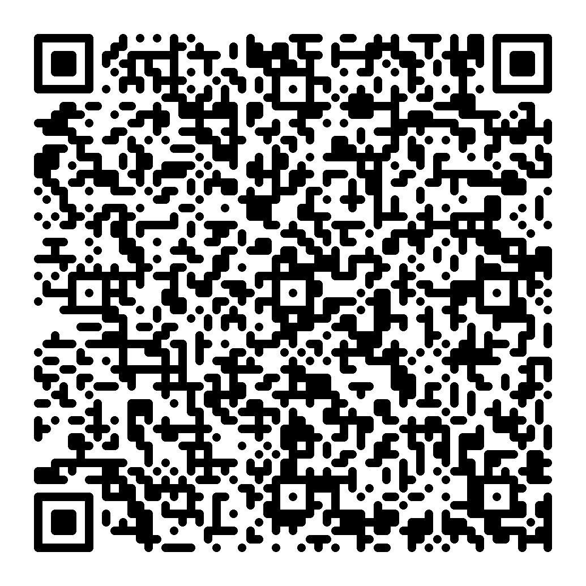
Support Autism SA
Scan the QR code to make a donation.
Your contribution helps support:
South Australia’s first Sensory Bus
Community education through The Spectrum
Inclusive workplaces through the Autism Friendly Charter
Resources and support for autistic people and families
Advocacy for a more inclusive society
Thank you for helping to create an inclusive society
where everyone can live the life they choose.

